Slide 1
Introduction to Matlab Programming
Dr. Zsolt Csaba Johanyák
John von Neumann University, Kecskemét, Hungary
johanyak.csaba@gamf.uni-neumann.hu

Slide 2














Contents

Slide 3
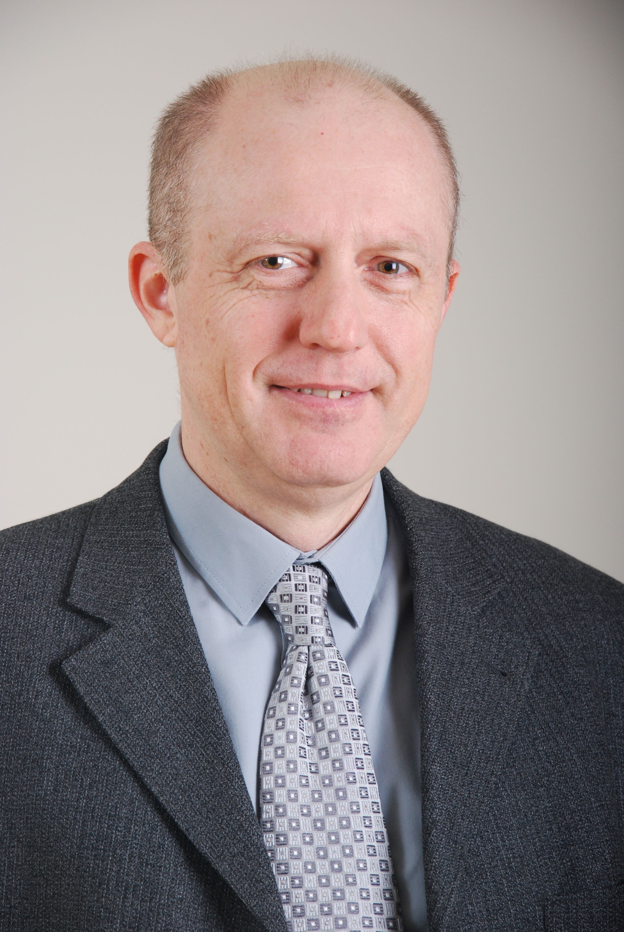
Dr. Zsolt Csaba Johanyák
Professor
Vice Dean for Scientific Afffairs and International Relations
http://johanyak.hu

Slide 4
City - University - Faculty

Slide 5
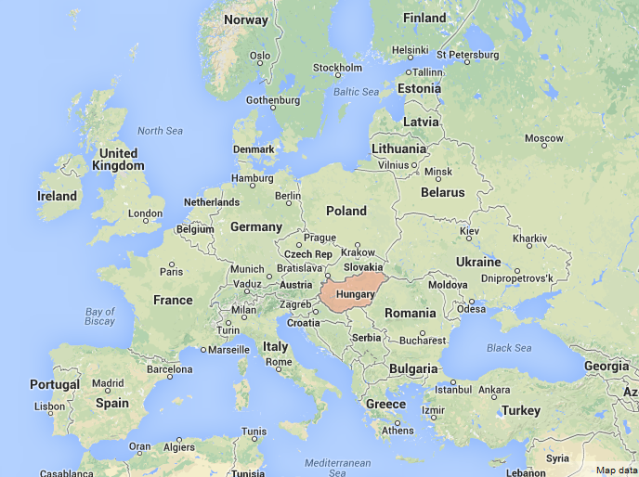

Slide 6
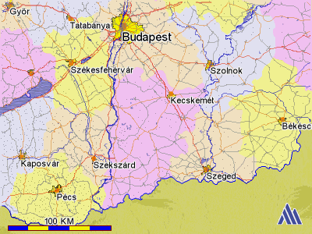

Slide 7
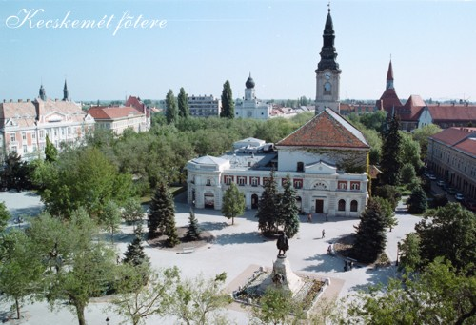
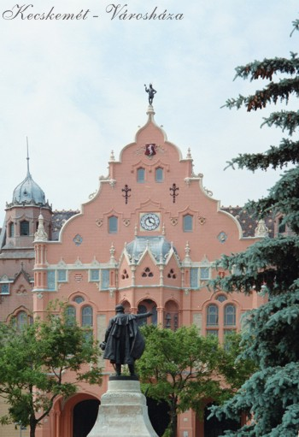
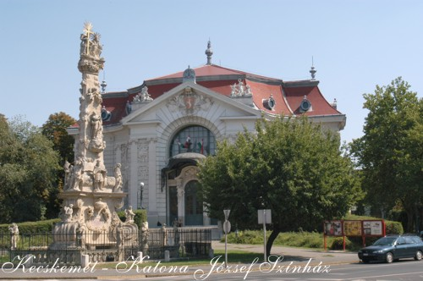
Historic places
Notes:
Kecskemét was mentioned as a market-town of the first time in a charter from 1368.
The Main Square was the former market-place and is known as one of the most beautiful city centres of Hungary.

Slide 8
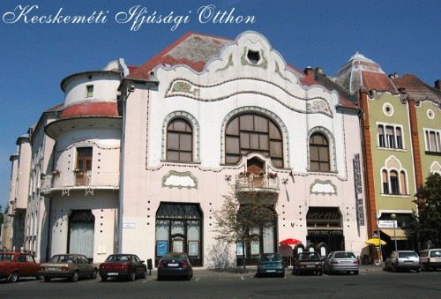
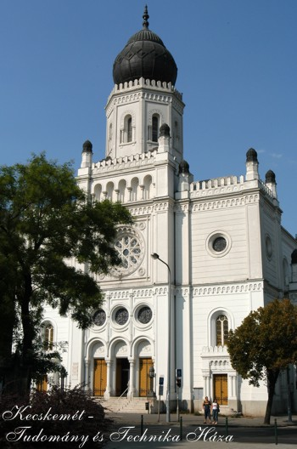
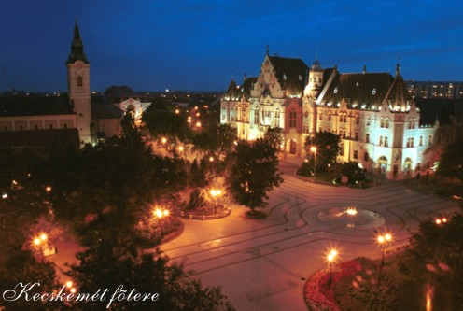
Historic places

Slide 9
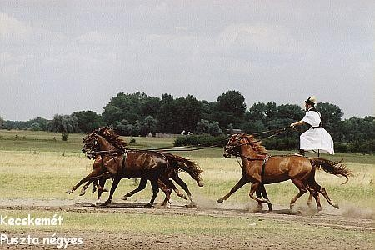
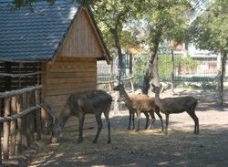
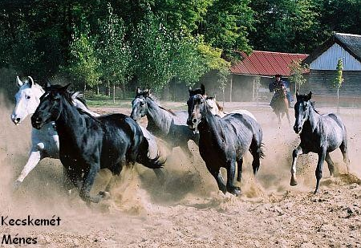
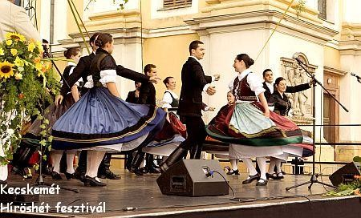
Traditions

Slide 10
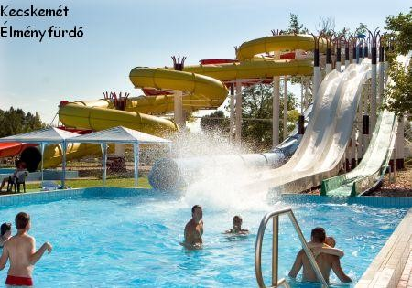
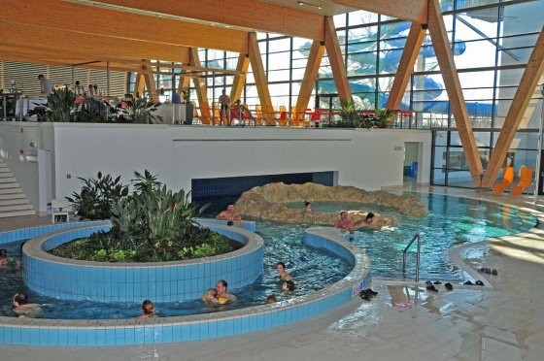
Wellness Tourism
The region of the Southern Great Plain is the sunniest part of Hungary.
It is the favourite place of the visitors looking for recovery, and recreation.

Slide 11
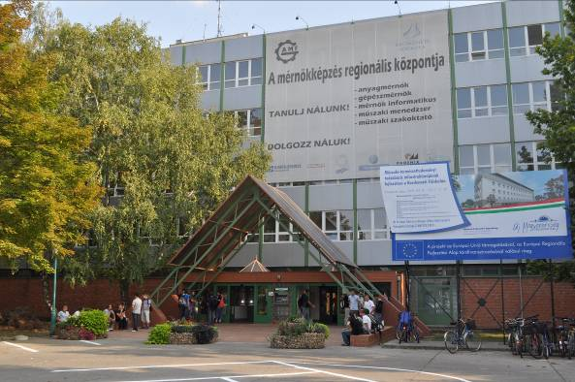
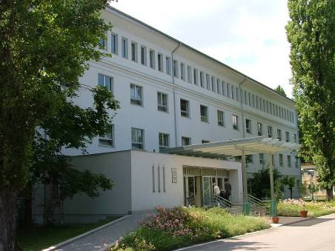
John von Neumann University GAMF Faculty of Engineering and Computer Science
Department of Information Technology

Slide 12
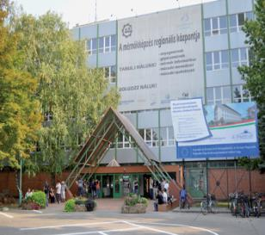
John von Neumann University
Significant center of higher education and research in the middle of Hungary
Diplomas in Engineering, Information Technology, Economy and Business Administration, Agricultural and Teacher Training
Creator of the dual training model in Hungary
Four faculties:
GAMF Faculty of Engineering and Computer Science
Faculty of Economics and Business
Faculty of Horticulture and Rural Development
Teacher Training Faculty
Number of students: ~4.000
Academic staff: ~200

Slide 13
GAMF Faculty of Engineering & Computer Science)
Founded 1964
Number of teaching staff 100
Total number of students ~2000
Full-time students ~70%
Part-time students ~30%
Departments 5

Slide 14
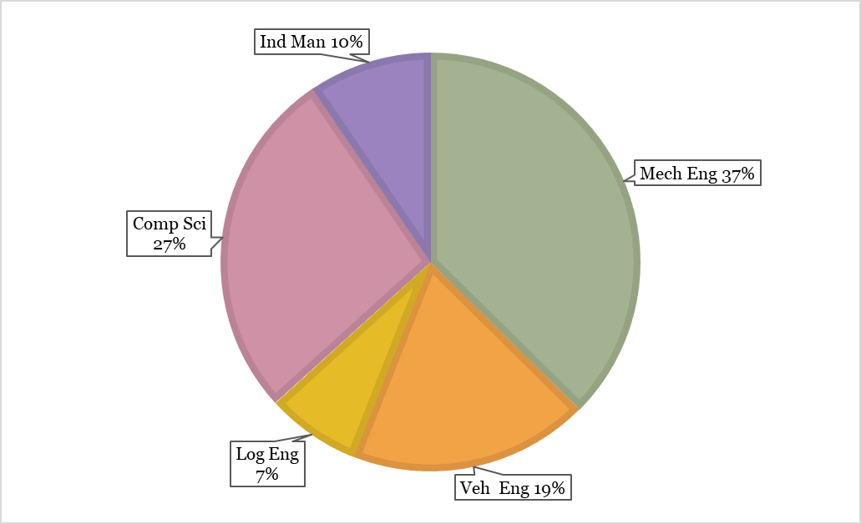
Study Programmes
Higher Vocational Training (4 semesters) (~2 %)
Information Engineering (Computer System Administration)
Software Engineering
Bachelor Level (7 semesters) (~84%)
Mechanical Engineering (BSc)
Computer Science Engineering (BSc) (HU+EN)
Computer Science Operational Engineer (BProf)
Vehicle Engineering (BSc)
Industrial Management (BSc)
Logistical Engineering (BSc)
Master Level (MSc)
Mechanical Engineering
Postgraduate specialist training courses (~14 %)
Software Engineering, Logistics, Quality management

Slide 15
Matlab Desktop and Command Window – Basic Operations

Slide 16
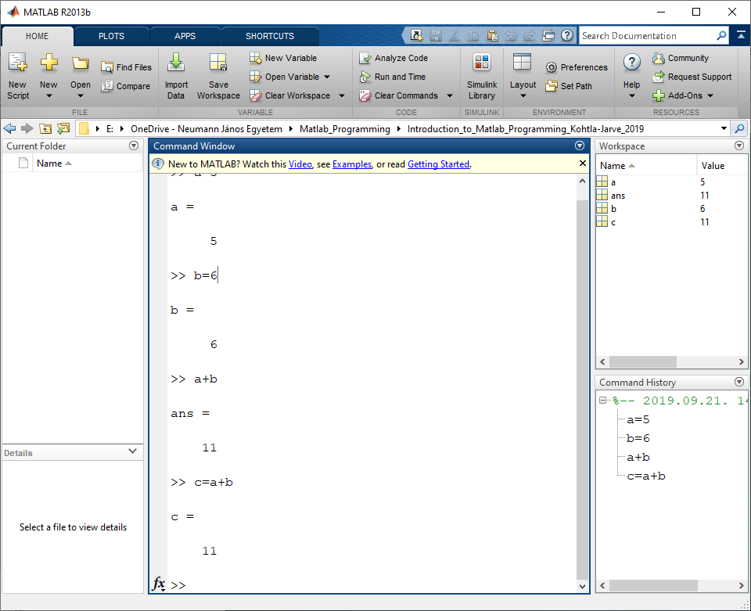
Matlab Desktop
Toolstrip
Current folder
Command Window
Basic operations: +,-,*,/,^
Workspace
History
Shortcuts
Documentation

Slide 17
Operator Precedence
-1^4 -1
(-1)^4 1
-1*5 -5
(-1)*5 -5
() and ^
Unary + and –
* and /
+ and -

Slide 18
Scripts and Functions
Conditional branch
Numerical and String data types
Using Scripts and Functions

Slide 19

Creating and Running a Script
Comments
Indentation
Using semicolons
If statement – conditional branch
Ex.: finding the roots of a second order equation
Numerical and string data types
Break points
Running a Script step-by-step
$x_{1,2}$=$\frac{−b±\sqrt{b^{2}−4ac}}{2a}$

Slide 20

Roots of a Second Order Equation Script
% % Calculate the Roots of a Second Order Equation % a*x^2+b*x+c=0 % % Ask the user for the parameters. a=input('a=') b=input('b=') c=input('c=') % Calculate the discriminant. D=b^2 - 4*a*c; % Calculate the real and complex roots. if D>=0 x1= -(b + D^(1/2))/(2*a) x2= -(b - D^(1/2))/(2*a) else real=-b/2/a; imaginary=(-D)^(1/2)/2/a; c1=[num2str(real) '+' num2str(imaginary) '*i'] c2=[num2str(real) '-' num2str(imaginary) '*i'] end
$x_{1,2}$=$\frac{−b±\sqrt{b^{2}−4ac}}{2a}$

Slide 21
Roots of a Second Order Equation Function
function [x1,x2] = RootsFunc(a,b,c)
% Calculate the Roots of a Second Order Equation
% a*x^2+b*x+c=0
%
% Calculate the discriminant.
D=b^2 - 4*a*c;
% Calculate the real and complex roots.
if D>=0
x1= -(b + D^(1/2))/(2*a);
x2= -(b - D^(1/2))/(2*a);
else
real=-b/2/a;
imaginary=(-D)^(1/2)/2/a;
c1=[num2str(real) '+' num2str(imaginary) '*i'];
c2=[num2str(real) '-' num2str(imaginary) '*i'];
end
end

Slide 22
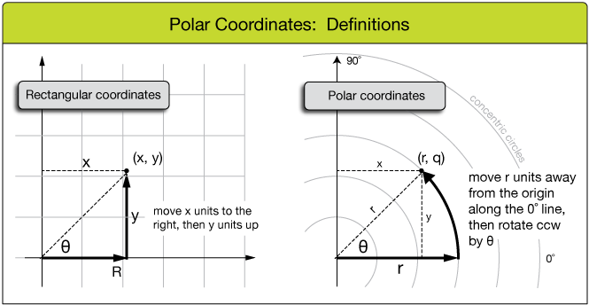
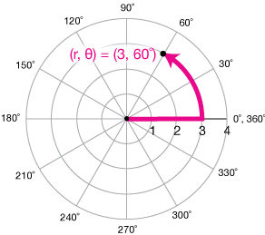
Ex.: Rectangular and Polar coordinates

Slide 23
Polar2Rect function
function [x,y]=polar2rect(r,theta)
% Function for coordinate transformation from polar
% to rectangularcoordinates.
% r - radius.
% theta - angle in radians.
x=r*cos(theta);
y=r*sin(theta);
>> [x,y]=polar2rect(50,pi/4)

Slide 24
Symbolic Math Toolbox
% % Solving an Equation using Symbolic Tools % % Clear workspace (delete previously defined variables). clear all % Define symbolic variable. syms a b c x % Solve equation. solve(a*x*x+b*x+c)

Slide 25
Symbolic Integration - Indefinite Integral
syms x
int(sin(x))
int(1/(1+(6*x-1)^2))
int(exp(x)*sin(x)^2)
int(1/(1+sin(3*x)^2))

Slide 26
Definite Integral
syms x
int(sin(x),0,1)
double(int(sin(x),0,1))
double(int(sin(x)^2,0,pi))
double(int(sin(log(x)),1,2))
double(int(1/sqrt((4*x-1)^2+11),0,3))

Slide 27
Derivative of a Function
%
% Symbolic Derivative Calculation
%
syms x
diff(sin(x))

Slide 28
Vectors and Matrices
Vectors
Matrices
Operations
Examples

Slide 29



Creating and Using Vectors and Matrices
a=[1 2 3 4 5]
b=[1;2;3;4;5]
c=a*b
b1=b'
d=a.*b1
e=a.^2
e1=d+e
f1=[1 2 3; 4 5 6]
f2=[1 2; 3 4; 4 6]
g=f1*f2

Slide 30
Operations
Matrix left division (\) x = A\B is the solution to the equation Ax = B
A=[1 2; 2 1];
B=[5;4];
x=A\B
Matrix right division (/) x = B/A is the solution to the equation xA = B
A=[1 2; 2 1];
B=[11 10];
x = B/A
+, -, *,/,\, ^
Element-wise: .*, .^ ,./

Slide 31
Vectorized calculation
% Vector containing the angle values.
fi=0:1:360;
% Transform in radians
x=fi*pi/180;
% Calculate the values of the trigonometrical % funtion sin .
s=sin(x);

Slide 32
Graphical representation
Plots

Slide 33
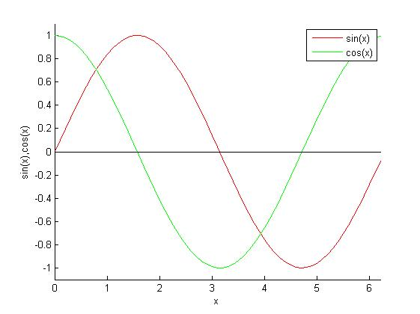
Plots
Using the Plots toolstrip
Customizing plots
x=0:0.1:2*pi; s=sin(x); c=cos(x); h=figure; % Create a window. hold all % Do not delete the previously drawn fugures. plot(x,s,'-r') % Plot the sin function with continuous red line. plot(x,c,'-g') % Plot the sin function with continuous green line. xlabel('x') % Define label for the abscissa. % Define label for the ordinate. ylabel('sin(x),cos(x)') % Define the showed area (lower and upper bounds in both directions). axis([x(1) x(63) -1.1 1.1]) % Draw horizontal axis. plot([x(1) x(63)],[0 0],'-k') % Draw vertical axis. plot([0 0],[-1.1 1.1],'-k') box off % Set background color white. set(h,'Color','w') legend('sin(x)','cos(x)')

Slide 34
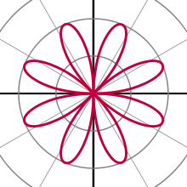
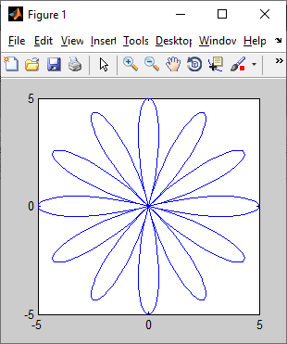
Polar rose
fi=0:1:360;
fir=fi*pi/180;
g0=0;
k=6; % k-petaled rose if k is odd, or a 2k-petaled rose if k is even
a=5;
r=a*cos(k*fir+g0);
[x,y]=polar2rect(r,fir);
plot(x,y)

Slide 35
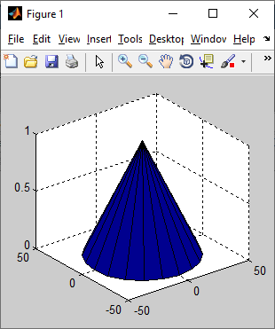
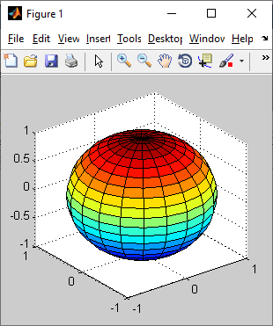
Cone & Sphere
[x,y,z]=cylinder([40 0]);
surf(x,y,z);
[x,y,z]=sphere(20);
surf(x,y,z)

Slide 36
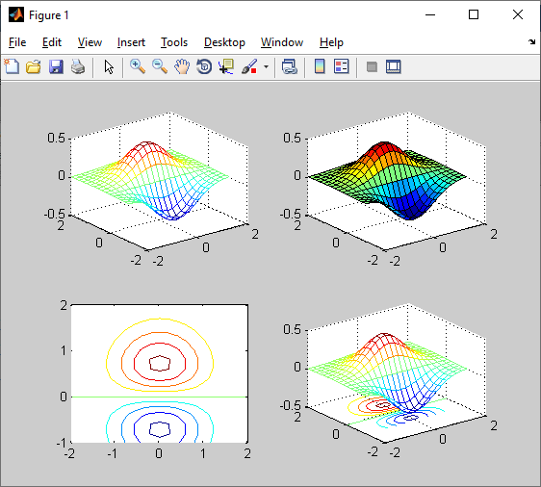
3D surface plot
x=-2:0.2:2;
y=-1:0.2:2;
[X Y]=meshgrid(x,y);
Z=CompFunc(X,Y);
h=figure;
subplot(2,2,1),mesh(X,Y,Z)
subplot(2,2,2),surf(X,Y,Z)
subplot(2,2,3),contour(X,Y,Z)
subplot(2,2,4),meshc(X,Y,Z)

Slide 37
Creating a GUI Application

Slide 38
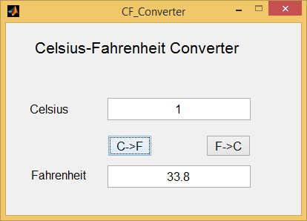
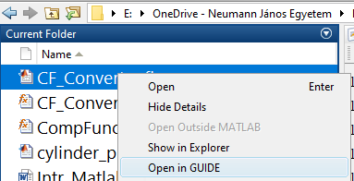
Temperature Converter
Home/New/GUI/Blank GUI/OK
Tag property

Slide 39
Celsius → Fahrenheit
function pbCF_Callback(hObject, eventdata, handles)
% handles structure with handles and user data (see GUIDATA)
str=get(handles.etCelsius,'String');
Celsius=str2double(str);
if isnan(Celsius)
errordlg('Please enter a correct value for degrees in Celsius')
else
Fahrenheit=((9/5)*Celsius)+32;
str=num2str(Fahrenheit);
set(handles.etFahrenheit,'String',str);
end

